Slide 1
System Architecture
System Servers
Container n
Container n
Load Balancer
Container
Container n
Container n
DB Container
Web Server
Containers
User Containers
Container Manager (LXD)
Linux OS
Host Machine

Slide 2
System Servers
Database
DB Container
Container OS: CentOS 7
Database: mySQL Ver 8.0.14

Slide 3
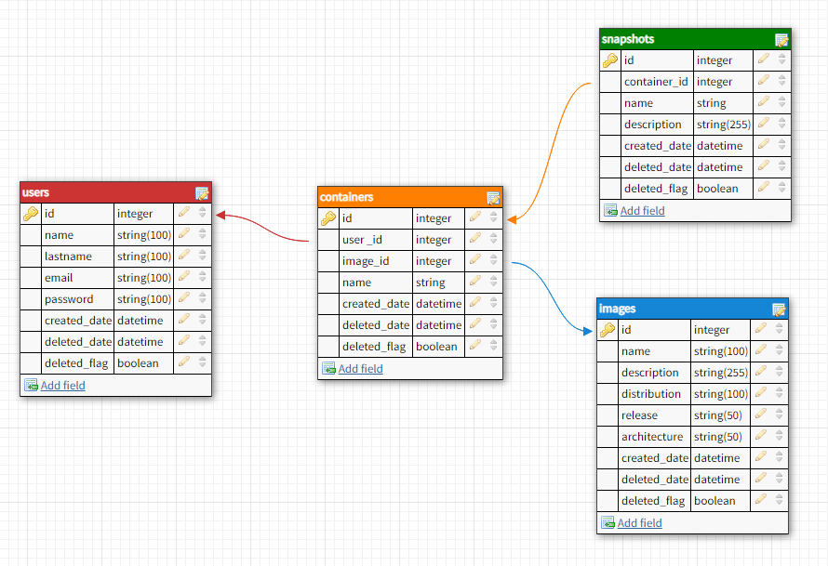
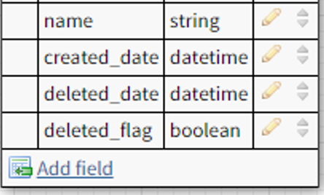
Database Design
status

Slide 4
System Servers
Load Balancer
Container OS: CentOS 7
Load Balancer: nginx/1.14.2 (with SSL)
LB Method: IP Hash
Load Balancer
Container

Slide 5
System Servers
Web Servers
Container n
Container OS: CentOS 7
Web Server: nginx/1.14.2 (with SSL)
Backend: node.js
Frontend: vue.js
Container n
Web Server
Containers

Slide 6
System Functionality
Web
Client HTTPS Request
Host Machine
Load Balancer
Web Server
Host Machine forwards the request to the Load Balancer
Load Balancer directs the request to the appropriate Web Server
Container Management
Client Container Action
Host Machine
LXD Backend API
User Container

Slide 7
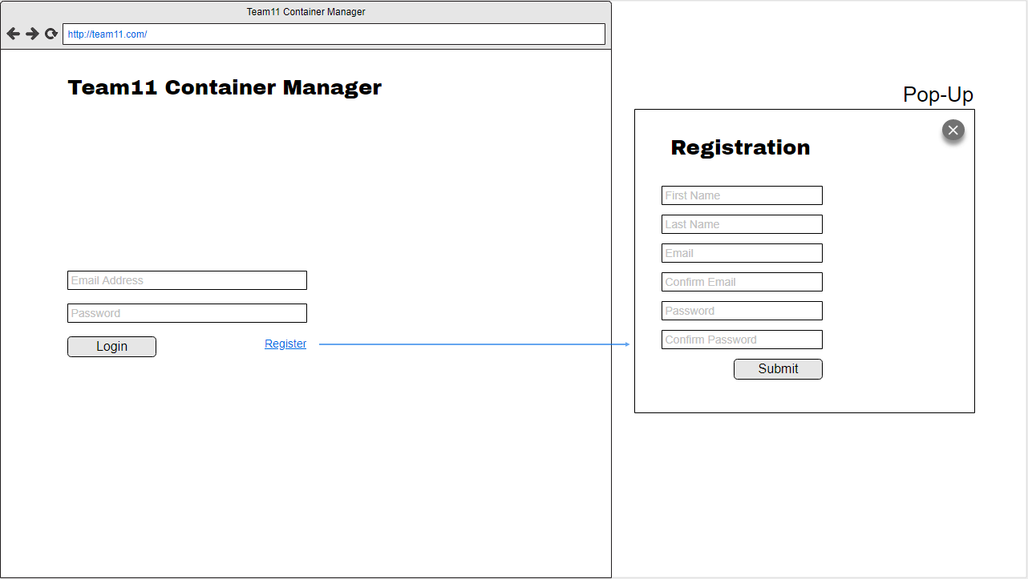
Mockups – Login Page

Slide 8
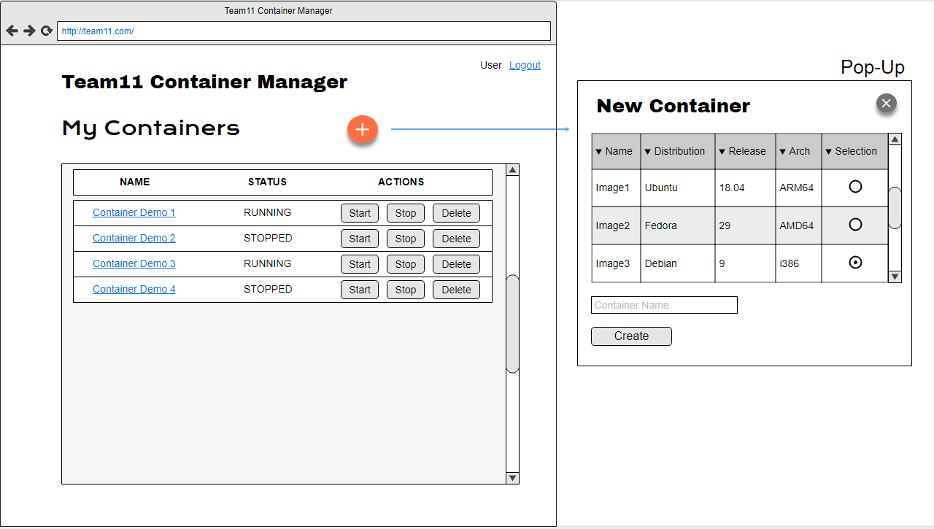
Mockups – Main Page

Slide 9
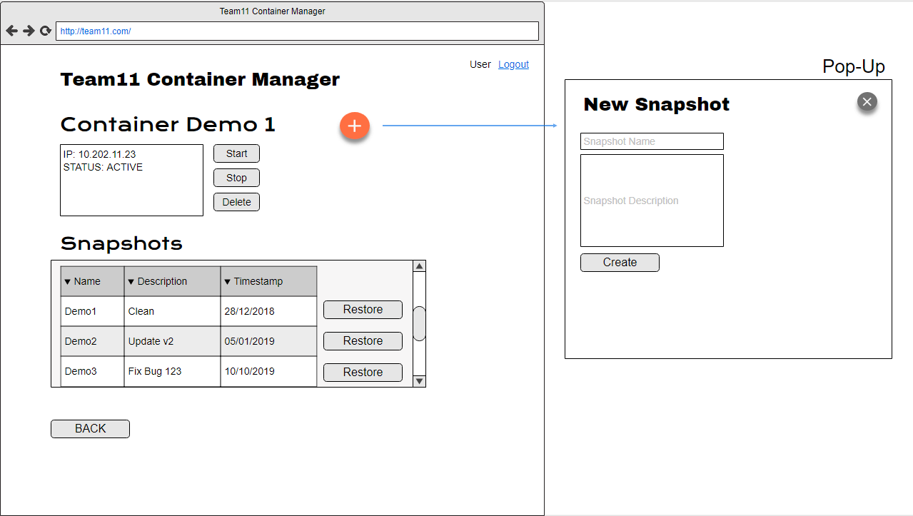
Mockups – Container Details Page

Slide 10
API Functions – Login Page
Check should be done in frontend
Function localhost:3000/register/first_name/last_name/email/password
Function localhost:3000/login/email/password

Slide 11
API Functions – Main Page
Function localhost:3000/search/images
Function localhost:3000/containers/container_name/user_id/start
localhost:3000/containers/container_name/user_id/stop
localhost:3000/containers/container_name/user_id/delete
Function localhost:3000/containers/create/container_name/user_id/image_id
Function localhost:3000/search/containers/user_id

Slide 12
API Functions – Container Details Page
Show user name and logout
localhost:3000/logout
Function localhost:3000/containers/container_name/info
Same container functions as the main page
Function localhost:3000/containers/snapshots/create/snapshot_name/snapshot_description/container_id
Function /containers/snapshots/restore/:snapshot_name/:container_id
Function localhost:3000/containers/snapshots/container_id/

Slide 13
Things To Take Into Account
Manage Connection sessions in frontend. PENDING.
Load balance sessions (nginx): Resolved using ip_hash as load balancing method. RESOLVED.
Secure connections. Implemented HTTPS in Load Balancer and Web Servers. RESOLVED.
Limit connection to user containers. Different pods. Solution: Create containers with LXD instances for each user.

Slide 14
Web Server Containers
To help manage the load of the web server containers.
SCRIPT:
The IP of the new container needs to be added to the Load Balancer nginx configuration.
A new user ‘team11cm’@’web-serverNN’ needs to be created in mySQL instance container.
Modify new Web Server nginx file to reverse proxy to it node.js application.

